Slide 1
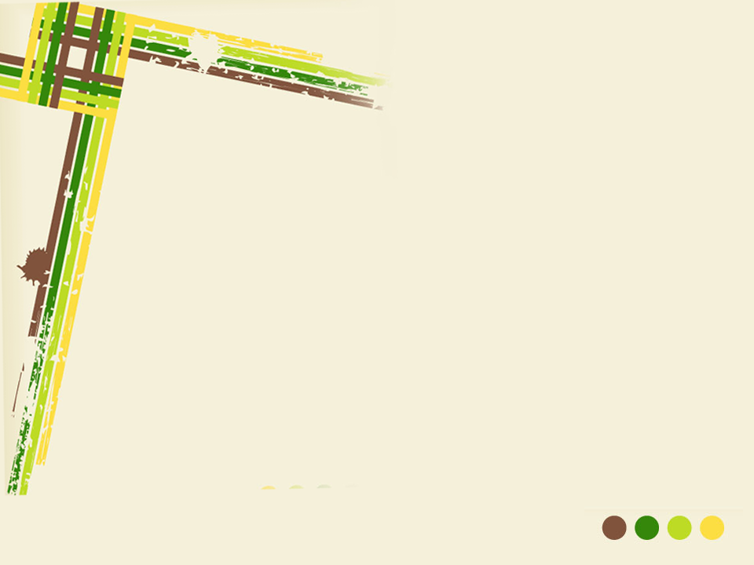
A smart phone application to support citizen journalism
Liu Tiantian
11 August 2014
Project presentation·

Slide 2
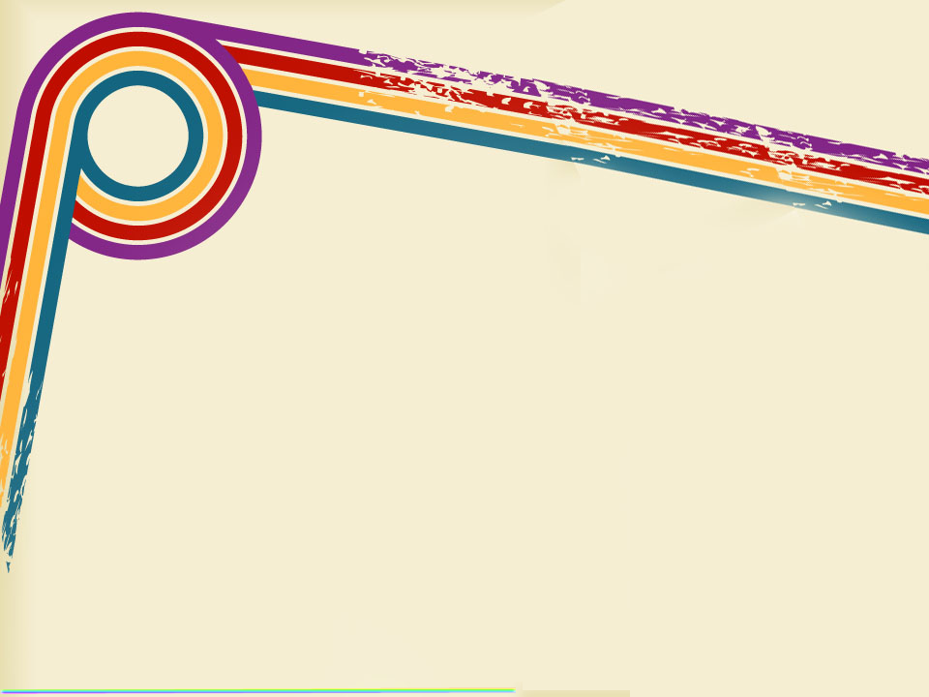

SpeakUp
project implementation

Slide 3


Logo: When people give speech or want to say some louder,
sometimes they hold this kind of microphone.
This logo easy to make user association of may be this
application can make us say something or this app
publicizes something to them.
Name: I named this application as “SpeakUp”. I think there
is a usage of paronomasia in this name . First speak
up always represent speak loud enough to be
audible. Second I wrote “Up” as uppercase, I want
to represent that with news that has been spoke
out, may be the level of civilization around us
can be increased.
SpeakUp

Slide 4

Welcome Page: Briefly represent the topic
again. “话俾你知” means telling you some
stories. “讲出来，让大家都知道”means
speaking out and letting others know.

Slide 5
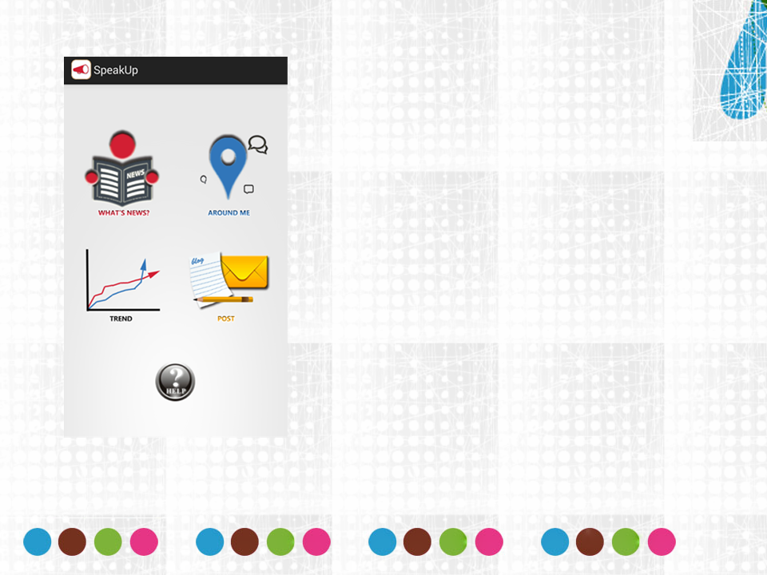
Home Page: Same as pre design.
Part a: WHAT’S NEWS
Part b: AROUND ME
Part c: TREND^{[1]}
Part d: POST
Part e: HELP^{[2]}
[1] I changed function of this part when
try to finish it. I will detail this later.
[2] Add this function to teach user how to
use this application.

Slide 6

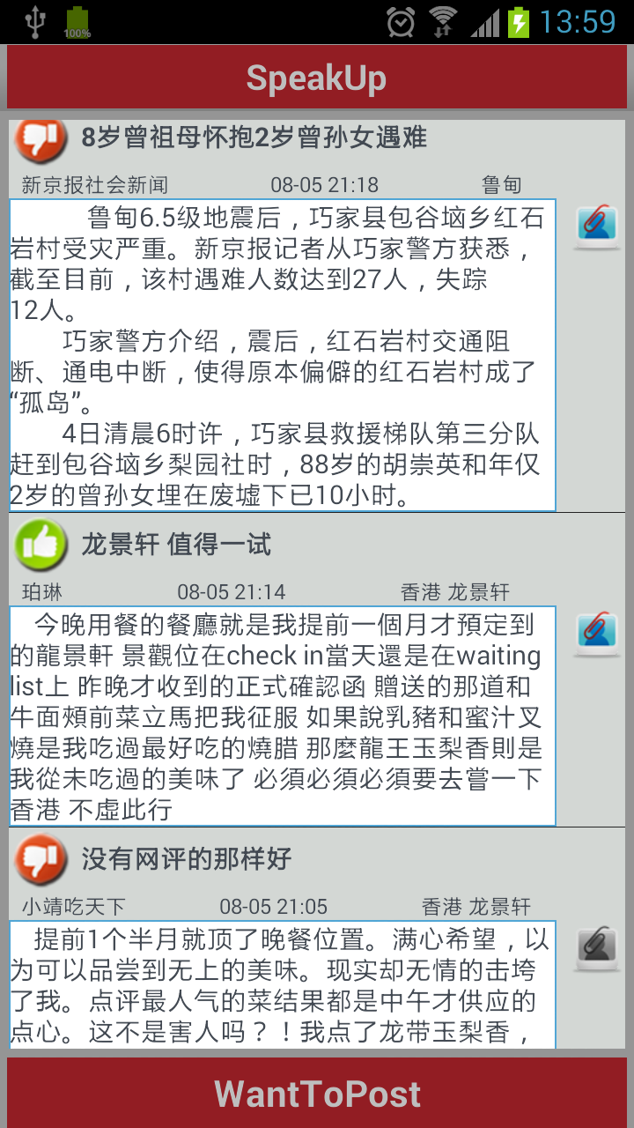
Part a:
This part used ListView with adapter
method to show news list.
When user tap WHAT’S NEWS icon,
this application will download latest
news from server^{[1]}.
User can check news one by one by
scrolling screen.
If user want to post a news, they can
click “WantToPost” icon to move to
part d directly.
[1]The server that I used for this app
is Parse. Parse is the perfect cloud
to save and download data.

Slide 7

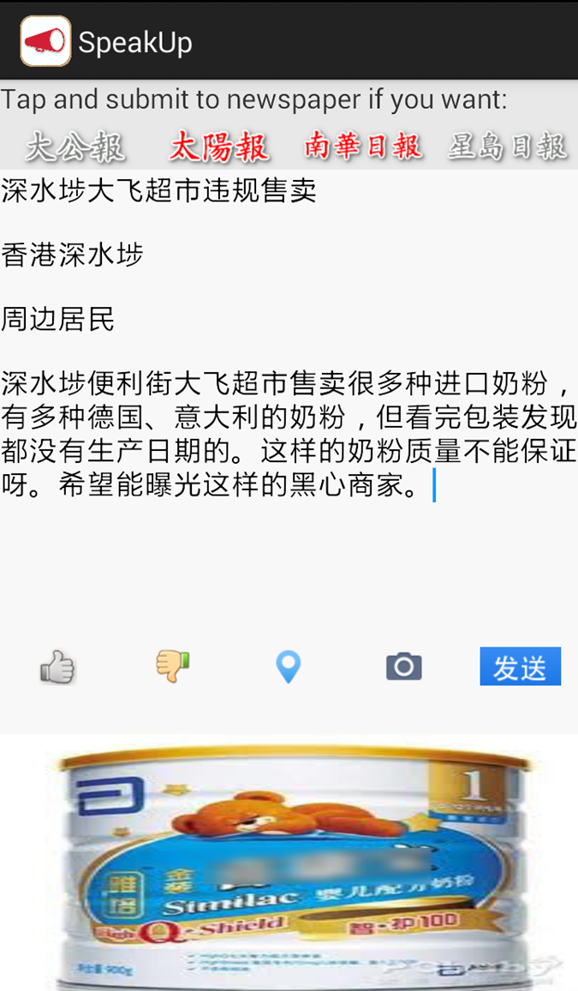
Edit news:
1.The editor want to submit news to “太阳报” and“南华早报”,so he highlight the two icons.
2.Edit news subject:
深水埗大飞超市违规售卖
3.Edit news happen area：
香港深水埗
3.Edit poster name:
周边居民
4.Edit news content：
深水埗便利街大飞超市……
5.Mark this news as a positive news
6.Set location
7.Attach a image
Just for sample

Slide 8
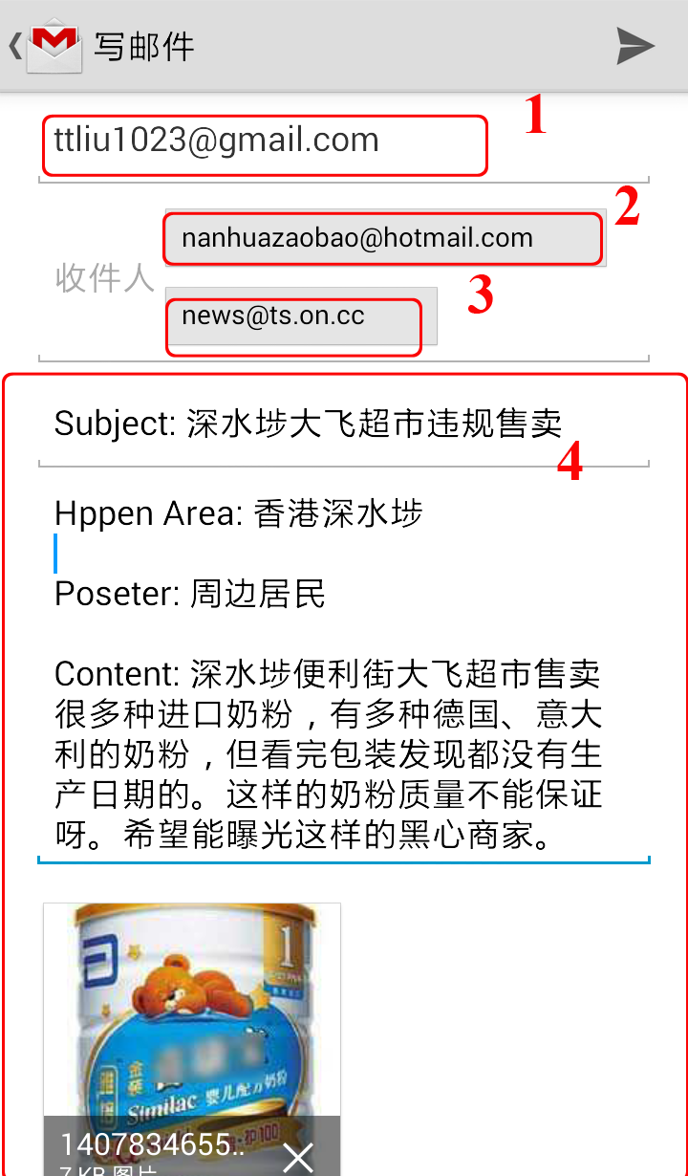
1.After tap the Sent icon， the news that user just edited will be sent to Parse server directly
2.Since user selected two newspaper to sent, so application will go to email edit interface.(Open the email application that user installed.)
3.Every part of the email as show in right image (1 2 3 4) can be shown directly. User can check the email but don’t need to edit again.
Edit news:
Just for sample

Slide 9

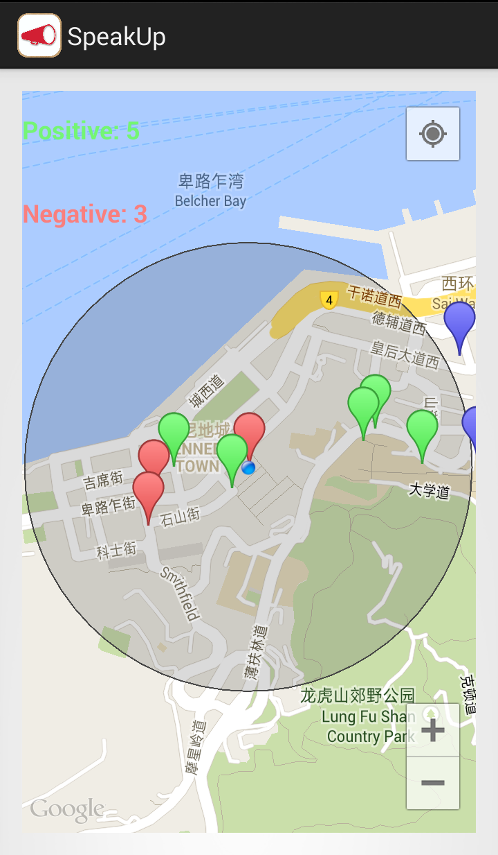
Part b:
Compare with part a, if user don’t want to spend lot of data to download news from server and maybe those news are far away from them, they can open part b and just check what are the news around them.
In this example, there are 5 positive news and 3 negative news around the user’s location.

Slide 10
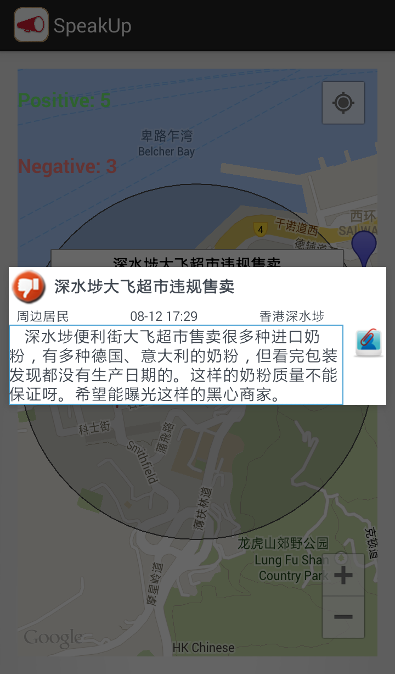
Check news details:
After check the total number
of news that around, if user want to check what the news say, they can see the news details by click the mark of that news.
PS: Green mark means this news is a positive news and red mark refers to negative news.

Slide 11

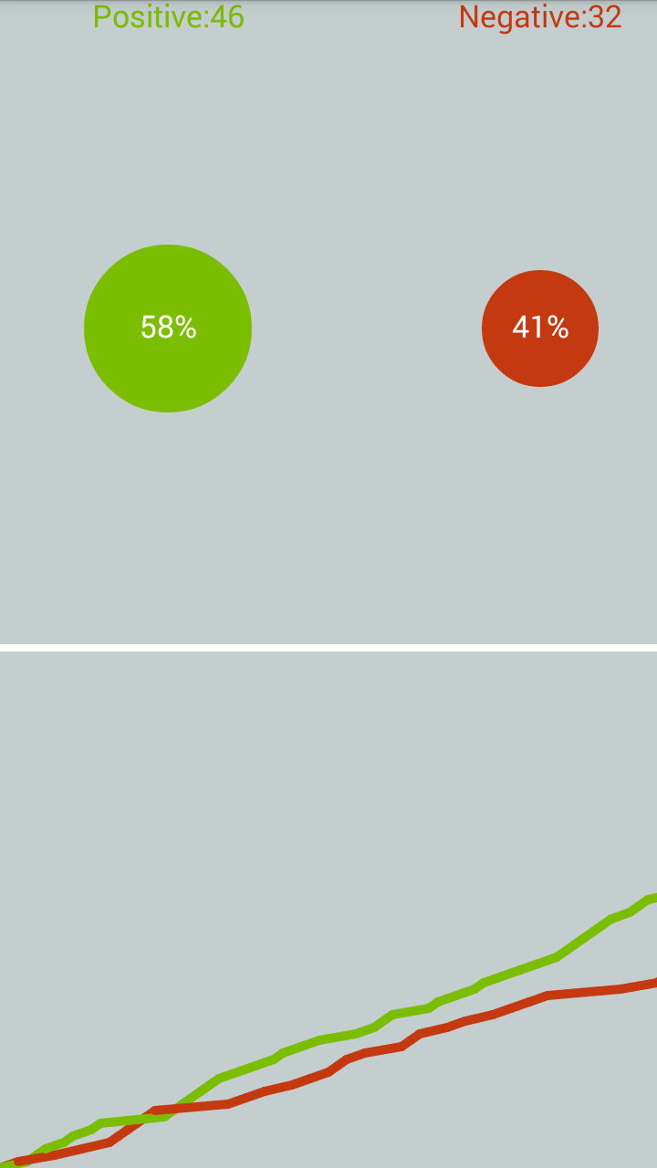
Part c:
This part will analysis the latest 100 news on the server, and count the positive news number and negative news number.
There are three kind of ways to visualize their numbers. Text shows on the top. Pie chart shows at the middle and line chart shows at the bottom.
Actually these works in dynamic. For example, cycle size of pie chart increase by the number raising.

Slide 12
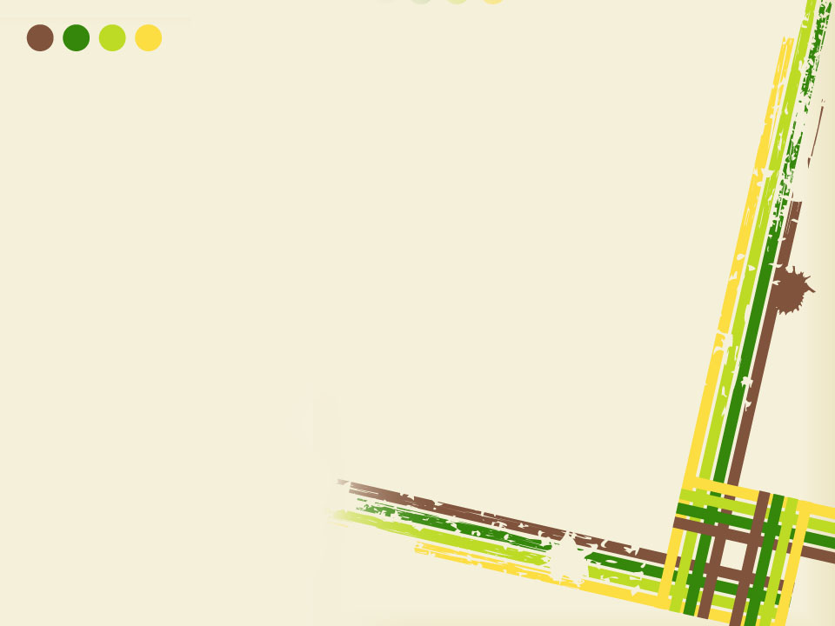
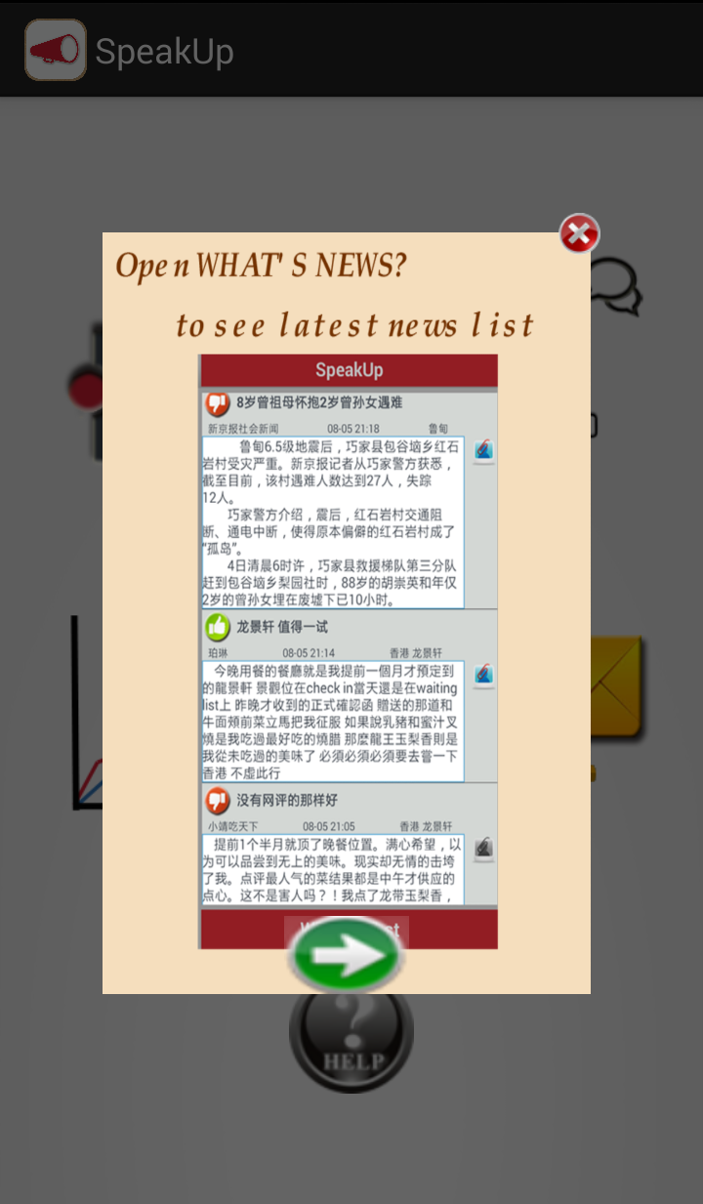
Part e:
I used the basic dialog to accomplish this part.
Briefly teach user how to use this application.

